Slide 1

Digital Library Website
For 3rd semester Mini project(KCS354)
Submitted to:- Mrs. Monu Singh
Suman Kumari (Roll no. :-1904920100088)
Rishikesh Yadav (Roll no. :-1904920100071)
Mahendra kushwah(Roll no. :-1904920100054)

Slide 2

Content
Introduction
Objective
Technical aspect
Functional requirement
Methodology
Current work
Future work
Conclusions
References

Slide 3
Introduction
Nowadays, we see that all the work is going online.
If anyone wants to watch movies then you can watch movies online, if you want to talk to someone many chat apps are available like Facebook and WhatsApp Messenger.
Even books have been online nowadays. And nowadays everyone knows the condition of this CORONA pandemic, almost all the work is being done online.
Like studying, teaching, meeting, interviews, even Courts are also running online.
So that when everything is online, there should also be an online library for students, where they get the books and notes of their subjects together in one place.
The main users of this library are teachers and students of our college.
This project is based on HTML,CSS.
Also, if students wants to take offline books they can easily borrow the books from our college library.

Slide 4
Objective
The main purpose of online college library is to provide study material like books, notes, assignments of their subjects in online mode.
Easy and attractive user interface who helps students to find where are books, where are notes and where are assignments.
To provide online academic services in future after the pandemic also.
In library not only course books available , other books, magzines , newspapers are also available for students.
There is no need to carry books your books and notes on your smartphone.

Slide 5
Technical aspect
We used the programming languages like HTML ,CSS.
For coding we use visual studio code
As an operating system we use windows 10
Requirements:-

Slide 6
Functional requirement
Login / signup
Navigate what you want
Search for your books, notes, and assignments
Download them
Do your assignments and upload them
Or you can request for offline book

Slide 7
Methodology
To implement the above goals, the following methodology needs to be followed:
In first stage, all HTML pages related to website is coded using visual studio code.
Then, we have to make books and notes page.
On Books/notes page we have to upload some books
Develop a database where all the books and notes are stored
And also, we have to develop a database for Login and signup data of users

Slide 8
Current work
Currently we are in coding phase.
We are using HTML & CSS basic
We are completed our library logo work
We are not so good in HTML so, we writing codes little bit slowly

Slide 9

Screenshots
LIBRARY LOGO

Slide 10
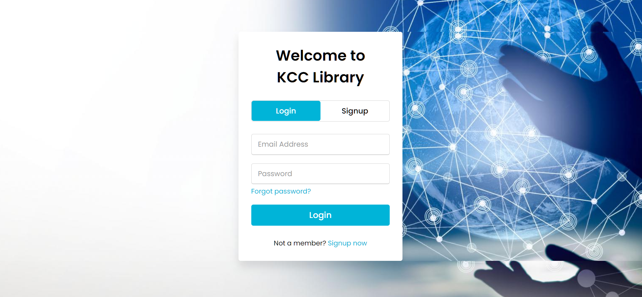
Screenshots
Login page

Slide 11
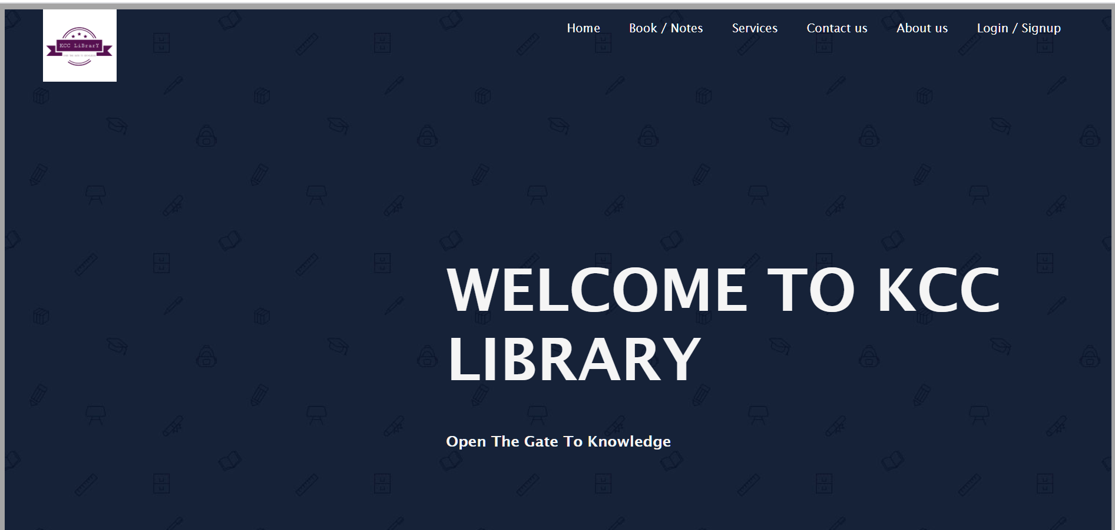
Screenshots
Home page

Slide 12
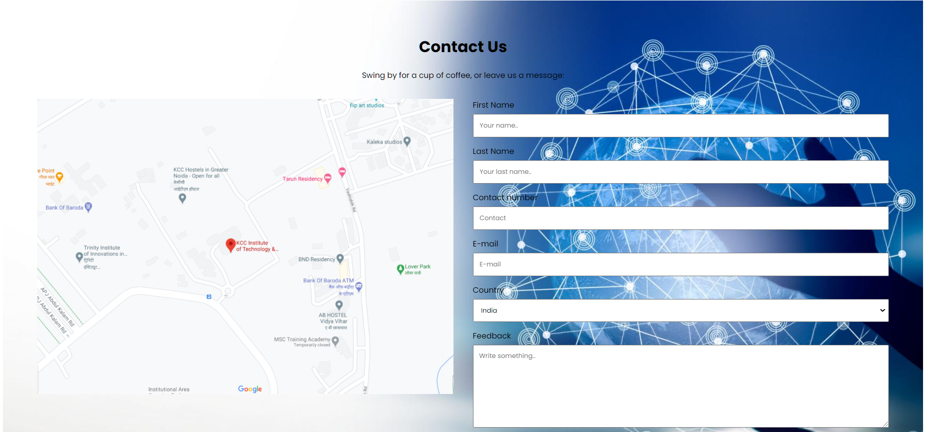
Screenshots
Contact page

Slide 13
Future work
In the near future, technology is growing rapidly so the online library system is very useful
Every students and teachers even they are of other colleges take help from this library.
Very easy to access, attractive and simplistic user interface, and no loss of time
In future we work on to add more privacy, so everyone got unique access and privacy.

Slide 14
Conclusion
This project was successfully completed, within the time span allotted.
All the modules are tested separately and input together to form the main system.
Finally the system is tested with real data and everything worked successfully. Thus, the system has fulfilled the entire objective identified.
The system had been developed in an attractive dialogue fashion.
So, user with minimum awareness about computers can also operate our site easily.
To conclude this, we thank all the people who help us to complete this project.

Slide 15
References
Book Reference :-
HTML & CSS Design and Build Websites, Jon Duckett
Web Design with HTML and CSS Digital Classroom, Jeremy Osborn, Jennifer Smith, and the AGI Training Team
Internet reference :-
https://www.w3schools.com/html/default.asp
https://www.w3schools.com/css/default.asp
https://www.w3docs.com/learn-html.html
https://codingblocks.com/

